Slide 1


Pivotal CF - Introduction

Slide 2
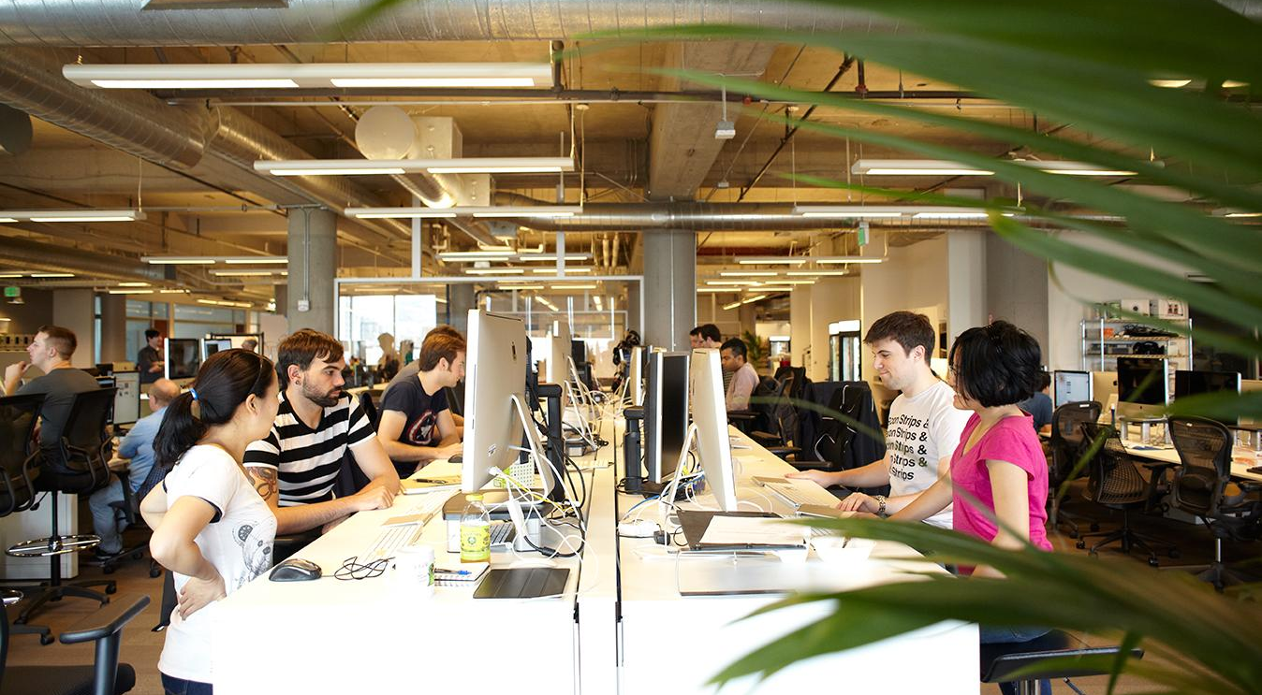
OUR MISSION:
Enable creation of high-quality software—at start-up speed—leveraging a modern cloud platform, a modern development process, and the power of Big Data to continuously drive innovation
Modern Software Methodology
Modern Cloud Platform
Big Data
Notes:
Businesses really face two very big challenges. How do they acquire the technical capability? How they transform the culture of the organization, to realize the full potential of these capabilities.

Slide 3



Key Themes
Speed
Scale
Security
Stability

Slide 4
Speed
Weeks to Days
Days to Minutes
Increase Revenue
Customer Alignment

Slide 5
Scalability
100’s to 1000’s of Containers
Auto scale
Containers/VM

Slide 6
Security
Continuous Patching
Continuous Credential Rotation
Live Container/Server Rebuild

Slide 7
Stability
Self Healing
Process State Monitoring
VM State Monitoring
Application State Monitoring
Multi-zone Aware

Slide 8
Speed (enables Agility)
Opportunity Cost
Insurance Co
Our product backlog has a story to enable “Digital Delivery of Policies to Customers for Signing and Approval”. Enabling this feature alone would save us approximately $5 million in printing costs in 2017
Payment Processing Firm
Quickly build an MVP application deployed on PWS that scales elastically and provides a consumable API for SMB customers not targeted by Direct Sales force
Built in conjunction with Pivotal via Hackathon
We estimate there is an additional $10 million market opportunity here in 2017 and want to test the hypothesis with this MVP

Slide 9
Speed (enables Agility)
Onboarding Clients
(Reduce time/effort in Onboarding new clients)
Time to Market
Client Impact: Take client onboarding from months to days i.e - Increase ability to service Mid Market Clients and onboard more clients
Revenue Impact: Avoid Lost client revenue: Estimated Loss over last 2 years was 4 clients and ~ $8million
 | Current Environment | With Pivotal Cloud Foundry*
Manual Steps | 10 | 1
Client Onboard Time (post environment available) | 4-6 weeks | 2-3 Days
Required Roles | 2-3 people (50% time commitment for 4-6 weeks) | 1 person (10-15% time commitment)
Environment | Shared, client limiting, costly | Private, non client limiting ,no add’l cost
Clean Up | Large effort to remove client information from environment | Push button tear down
Test Environment for new clients
(Eliminate client loss due to extended lead times)
 | Current Environment | With Pivotal Cloud Foundry*
Manual Steps | 15 | 1
Environment setup | 6 months | 2-3 Days
Required Roles | 29 | 1
Downtime | Minimal | Zero

Slide 10
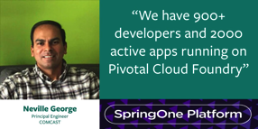
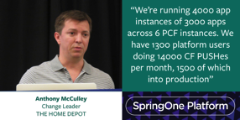
Speed (drives Productivity)
Operator Productivity
Pivotal Web Services runs ~40,000 containers, supports ~10,000 developers with 4 operators
Comcast supports ~2000 enterprise applications and 900+ developers with 4 - 6 operators
Large Telco supports ~22 Development teams, ~1800 containers, 13 foundations across 10 data centers with 1+ Operator

Slide 11
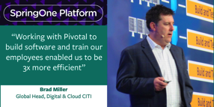

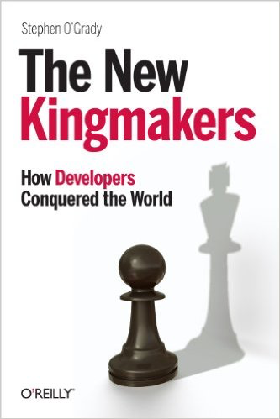
Speed (drives Productivity)
Developer Productivity
Setup and verify development environment
Installing Middleware
Installing Monitoring
Network Setup
Test Validation
Integration Testing
Pre-deployment and Soak Testing
Application Packaging & Deployment
Troubleshooting
OR
Writing Code?
Measure and Eliminate Yak Shaving

Slide 12
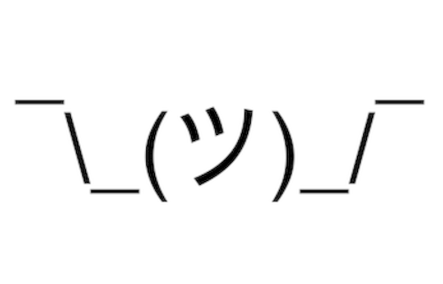
Stability
Usually Measured
Usually
Business Costs due to Planned and Unplanned downtime
Customer Use Case
PCF potentially saves ~$17M-$34M in business costs due to improved resiliency
Assumptions
Client’s downtime went from 29,234 minutes per year to 12,000 mins. That is ~17,000 mins
PCF attributed to 20%-40% of the improvement = 3400 - 6800 mins
Based on ~$5000 in business impact per min this means $17M for an Year
Notes:
PCF has High Availability built into every layer of the platform

Slide 13
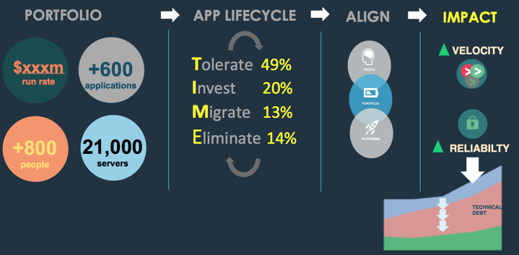
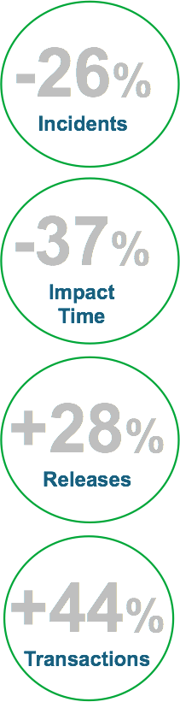
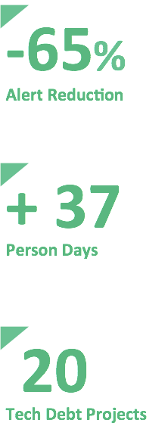
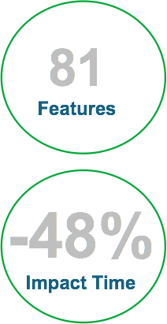
Stability
Customer Use Case Results
Operational Risk
DevOps Life
Results
Notes:
PCF has High Availability built into every layer of the platform (5 levels of HA)

Slide 14
Security - Reduce risk by going faster.
Immutable consistent infrastructure
Consistent and automated full-stack platform patching and upgrades (ZDD)
Cost based scheduler
Hardened container boundary (unprivileged user)
Infrastructure as Code
Fully encrypted network
Monitoring via Anti-virus bundled into platform
Credential rotation
Notes:
PCF has High Availability built into every layer of the platform (5 levels of HA)

Slide 15
Security - Reduce risk by going faster.
App level SSO
Container patching at Scale
Notes:
PCF has High Availability built into every layer of the platform (5 levels of HA)

Slide 16
Scale
PCF is Next Generation Middleware with Cloud Portability and Scalability
What is in the “box”
VM Consolidation (by leveraging containerization)
Automated Infrastructure Provisioning
Application Server
Monitoring
Load Balancing and Routing
Auto Scaling
Linux Subscriptions
Customer Use Case
Use of PCF ensured >50% reduction in hardware costs
Category | Costs
Server Hardware | $10M
Rack Costs | $12.6M
Facilities and Networking | $9.6
IT Labor Costs | $6.5M
Total | ~$40M
Total Savings | $20M*

Slide 17
In Summary
Speed
Scale
Security
Stability

Slide 18
Questions
How do you measure Development Velocity today?
What is the size of your custom applications footprint?
How do you capture Security compliance today?
What is your mean time to recovery when Apps fail?

Slide 19
CUSTOMER STORIES
Notes:
Presenter todo: tell one story that is relevant to this customer or audience
https://docs.google.com/spreadsheets/d/1rGyQVwJAiJO9rs2bom6iK6m8v_ghuruL6mIfCrRbYus/edit#gid=0

Slide 20
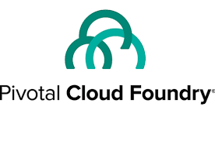
What is Pivotal Cloud Foundry?
Pivotal Cloud Foundry is a platform for developing and running cloud applications

Slide 21
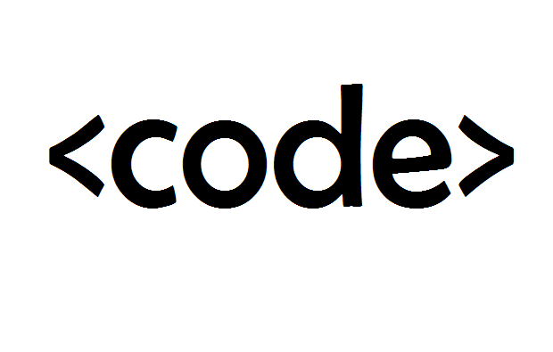
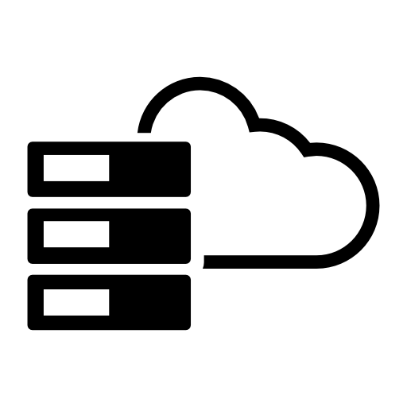

Cloud Foundry Principles
Developer Productivity
Operational Efficiency
Enhanced Security Posture

Slide 22
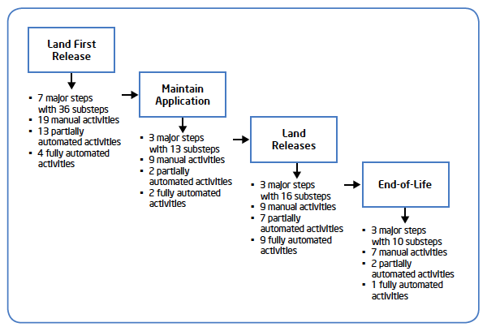


Traditional App Lifecycle: Lengthy & Complex
Traditional App Deployment:
8+ manual steps, developers out of the workflow
Traditional App Lifecycle:
Each phase compounds time and complexity, sacrificing agility
Developer
Operators
Request Servers
Wait for hardware/VM creation
3-7 major steps
7-19 manual activities
2-13 partially automated acts
2-9 fully automated activities
Setup Operating System
Install Software
Setup monitoring
Deploy website
Check / Test
Add to Load Balancer
...

Slide 23
The Power of PaaS
Business Value, Agility & Cost Savings
Traditional IT
IaaS
PaaS
Applications
Applications
You Manage
Applications
Data
Data
Data
You Manage
Runtime
Runtime
Runtime
Middleware
Middleware
Middleware
You Manage
Pivotal CF
+
Choice of IaaS
O/S
O/S
O/S
Virtualization
Virtualization
Virtualization
Servers
Servers
IaaS
Servers
Storage
Storage
Storage
Networking
Networking
Networking

Slide 24






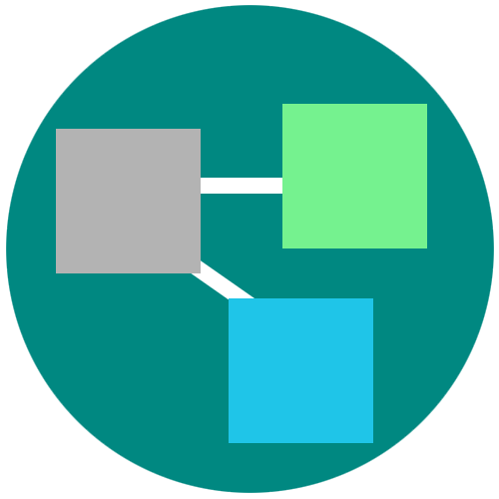
Everything to Deploy and Manage the App
Roles and Policy
Log aggregation
Security and Isolation
APM
Scaling
APPLICATION
Health management
Blue green deployment

Slide 25
The Developer Dream Haiku
Here is my source code,
Run it in the Cloud for me,
I do not care how

Slide 26
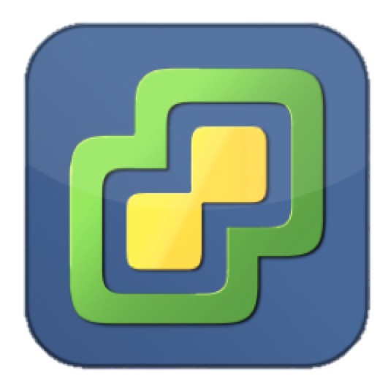
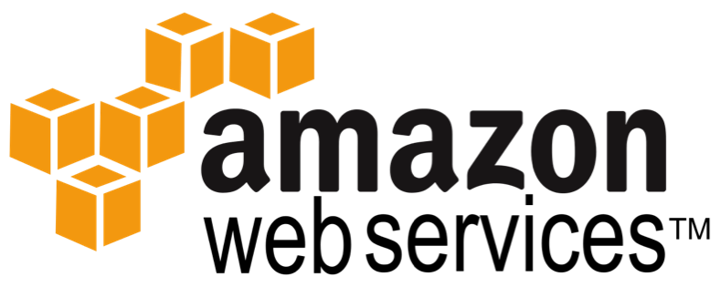
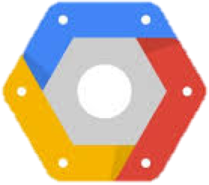
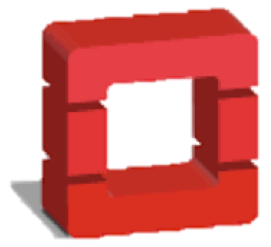
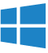
Pivotal Cloud Foundry Architecture
Platform Runtime (Elastic Runtime)
Services
Routing
Container Scheduling
Service Discovery
Configuration
Database
Application Framework
Big Data
12 Factor Apps
Microservices
RESTful Services
Circuit Breakers
Object Storage
Mobile
Java / Spring Boot
.NET
Node.js
Ruby
Build CI
Logging & Metrics
Network Security Groups
User Provided
Operations
Zero Downtime Deployments
Failover & Recovery
Scaling
Security Patching
Platform
Upgrades

Slide 27

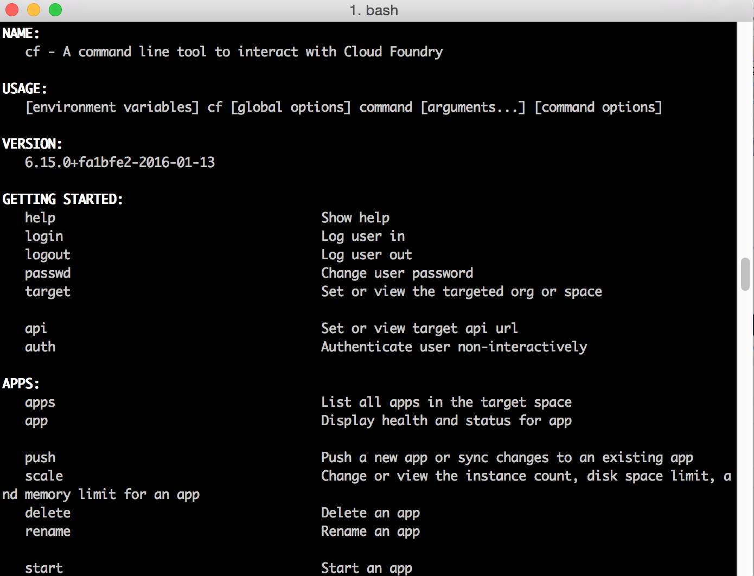
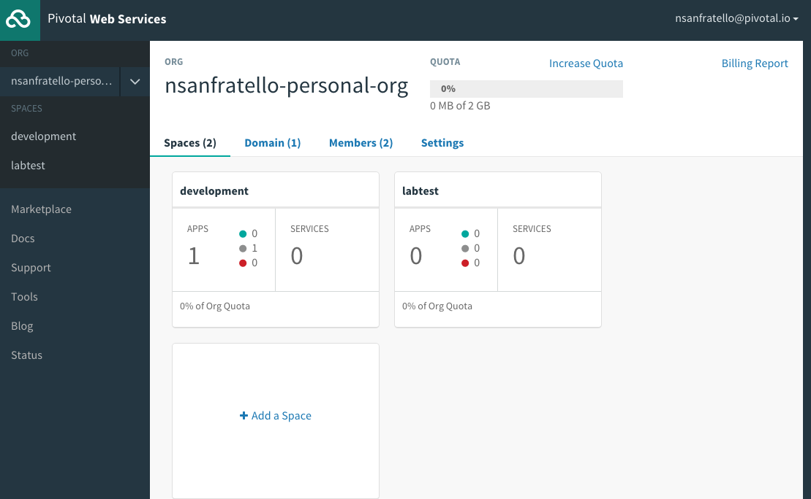
Interacting with Cloud Foundry

